Slide 1
AI Ride
Fast and Easy AI transportation solution.

Slide 2
Benefits

Slide 3
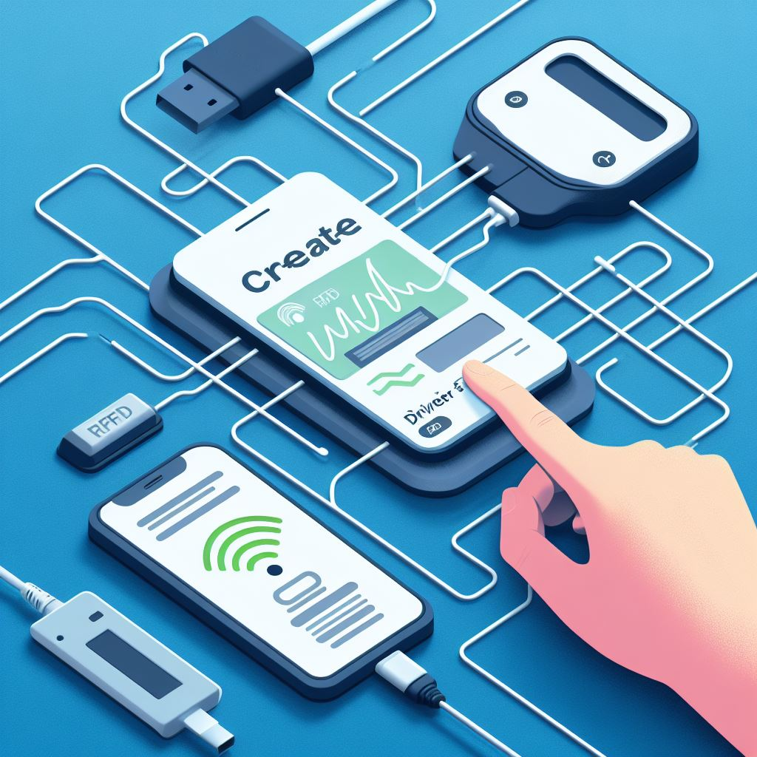
Benefit
Ablility to chat with Google AI enabled bot for locations

Slide 4
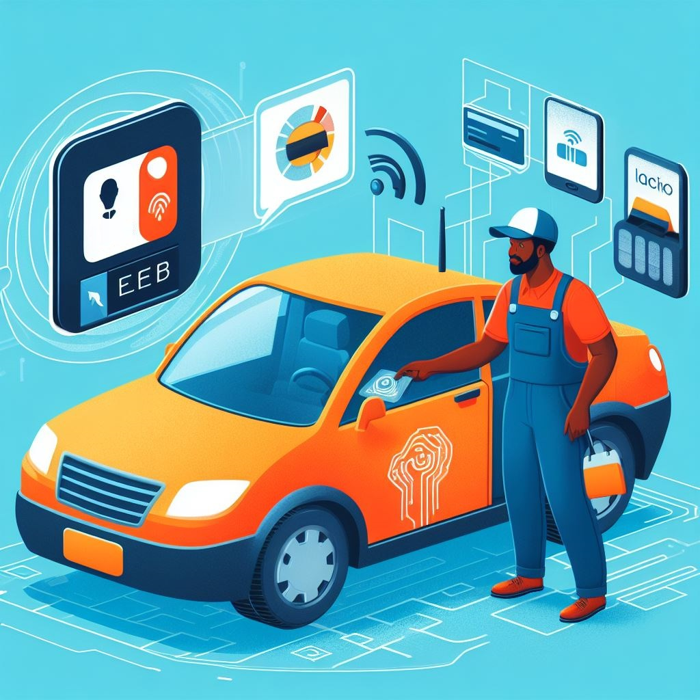
Benefits
Payment system powered by Square

Slide 5
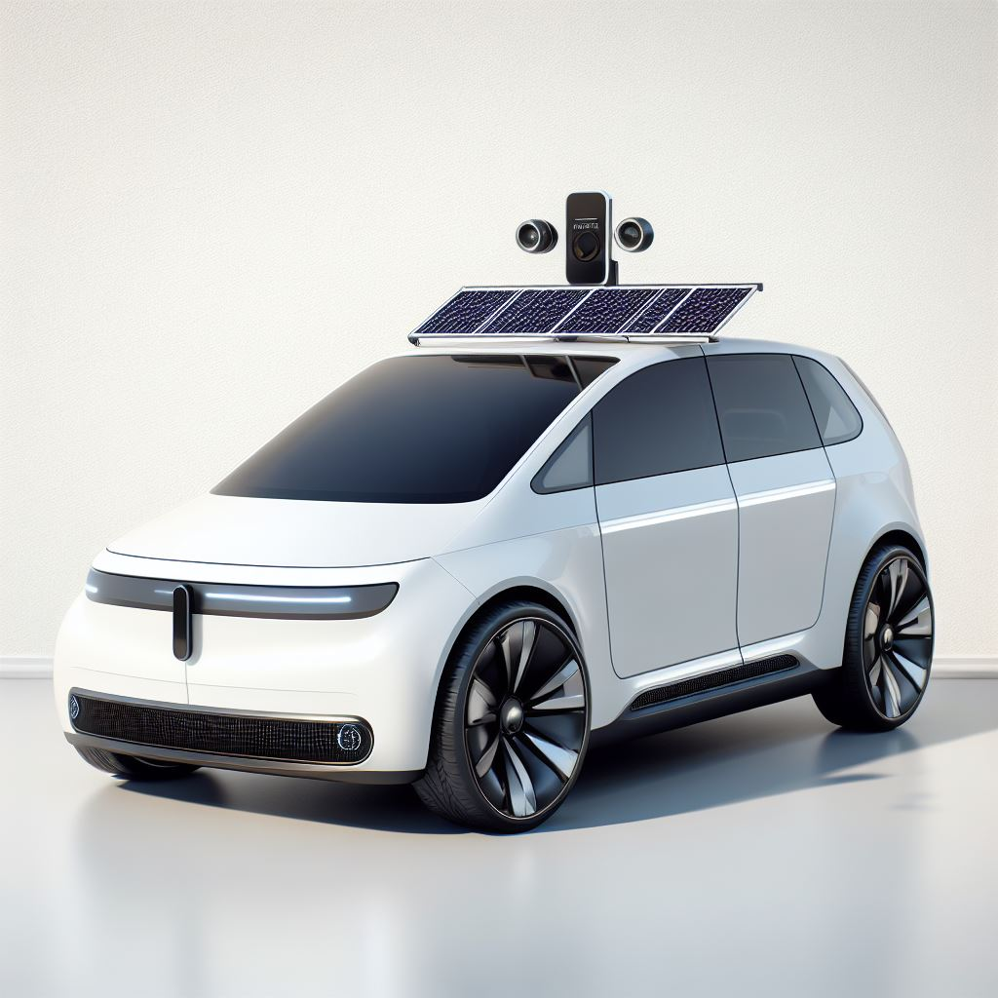
Ability to connect with shuttle providers

Slide 6
All is done automatically

